Slide 1




Seren’s International Opportunities in 2020

Slide 2



An overview
Note: Please review all aspects of this document and the individual programme websites prior to submitting an application to the Yale Young Global Scholars Program or the Harvard Summer School in 2020.
Please note that the hyperlinks included within this presentation will only work if this document is accessed in PowerPoint and in ‘Play’ mode.
Seren International: the story so far
Alumni feedback: transformational experiences
International opportunities & support in 2020
Seren-Yale Young Global Scholars (YYGS) Partnership in 2020
Seren-Harvard Summer School Scholarship in 2020
Seren-University of Chicago Summer Session Partnership in 2020
Finding out more: Webinars & Live Q&As
Further questions & support

Slide 3
Seren International: the story so far
2018: Seren established its first international offering, partnering with the Yale Young Global Scholars Program at Yale University to support 16 Seren pupils to attend the two week academic programme attended by students from over 100 different countries.
2019: Seren expanded its international reach, more than trebling the number of Seren students attending international summer programmes, supported by the Welsh Government, our university partners and sponsorship from a range of organisations.
28 Seren students attended the Yale Young Global Scholars Program at Yale University
2 Seren students attended the YYGS Program at the Yale Center in Beijing
23 Seren students attended the Harvard Summer School Pre-College Program
“I want every pupil in every school in every part of Wales to know that if you work hard then no academic opportunity is off-limits. I think this is a perfect example of what is possible!”
— Kirsty Williams AM, Minister for Education, Welsh Government
￼

Slide 4



Transformational experiences & impact
Ellie Rees, Swansea, St John’s College (USA)
How has YYGS impacted you? “It has impacted my world view…despite my age I can still change things…despite different backgrounds and opinions people undeniably are good and can get along and change the world for the better…a few friends and I are creating blogs to speak out against injustice from Bangladesh to Zimbabwe. The global connections I now have has really impacted me.”
“I bonded with lecturers and stay in contact with them…I made incredible friends who have changed my view of the world forever…I’m going to Germany in October to visit friends…from Rwanda and Zimbabwe. YYGS exceeded expectations due to its rigour and the people, who were incredible, supportive & helpful…I couldn't have wished for a better experience.”
Tom Long, Pembrokeshire, University of Oxford
How has YYGS impacted you?
“1. Experiencing America was amazing; 2. The lectures and seminars were really exciting; 3. Chatting to other students about academic subjects; 4. Chatting to other students about cultures and differences; 5. Living the college life; 6. The great atmosphere; 7. The friends I’ve made; 8. The exposure to other learning methods; and 9. Opening my eyes to university in America and the feasibility”
“I am more open to new ideas, and less stuck in my little bubble I can see the opportunities and support that are available to people all over the world and how important it is for me to get out there and put myself in the mix.”
Guto Tegid, Anglesey, Kings College London (KCL)
How has YYGS impacted you? “It has expanded my horizons by learning about different cultures and thinking critically about issues using opinions of those from all around the world”
“I met people from all around the globe…I was pushed academically, much more than expected…it was a chance to think critically about contemporary issues…there were so many different experiences offered throughout the two weeks”
“I can’t thank Seren enough for all the support given — an absolutely fantastic opportunity”

Slide 5
International opportunities & support in 2020
Yale Young Global Scholars (YYGS) Program
Two-week residential summer programme at Yale University, USA
Up to 30 funded spaces for Seren students (covering programme fees of $6,300/student)*
Study undergraduate level courses in STEM, Arts & Humanities or Social Sciences
Explore and discover a wide range of specialist topics within your chosen interdisciplinary subject area
Study alongside students from 100+ countries
Find out more & apply**: globalscholars.yale.edu
Harvard Summer School Pre-College Program
Two-week residential summer programme at Harvard University, USA
Up to 20 funded spaces for Seren students (covering programme fees of $4,850/student)*
Study undergraduate level courses in STEM, Arts & Humanities or Social Sciences
Focus intensely on one topic area within your chosen subject
Study alongside students from 100+ countries
Find out more & apply**: summer.harvard.edu
*The funding available through Seren’s partnerships and scholarships will cover programme fees, including tuition, accommodation, board/meals, activities & health insurance. Other costs will include flights, airport transfers, and miscellaneous expenses such as spending money. Please note that separate additional sponsorship is being raised from a range of organisations and individuals to support the costs of flights for the successful students most in need of this additional support (eligibility criteria will apply).
**To apply for funding through Seren’s partnerships, students must complete the 2020 Seren International Summer Programme Scholarship Application Form (click here) in addition to applying directly to the Yale Young Global Scholars or Harvard Summer School programmes.

Slide 6
International opportunities & support in 2020
University of Chicago Summer Session
Apply to either the Immersion Summer Session or the Pathways Summer Session
Three-week residential summer programme at the University of Chicago, USA
Up to 4 funded spaces for Seren students (covering programme fees of $7,100/student)*
Study undergraduate level courses in STEM, Arts & Humanities or Social Sciences
Explore and discover a wide range of specialist topics within your chosen interdisciplinary subject area
Courses examples: Biotechnology in the 21st Century; Economics from an Experimental Perspective; The Physics of Climate & Weather
Study alongside students from 100+ countries
Find out more & apply**: https://summer.uchicago.edu
*The funding available through Seren’s partnerships and scholarships will cover programme fees, including tuition, accommodation, board/meals, activities & health insurance. Other costs will include flights, airport transfers, and miscellaneous expenses such as spending money. Please note that separate additional sponsorship is being raised from a range of organisations and individuals to support the costs of flights for the successful students most in need of this additional support (eligibility criteria will apply).
**To apply for funding through Seren’s partnerships, students must complete the 2020 Seren International Summer Programme Scholarship Application Form (click here) in addition to applying directly to the Yale Young Global Scholars or Harvard Summer School programmes.

Slide 7


Seren-Yale Young Global Scholars Partnership in 2020
Summary of the programme
Courses & dates
How to apply
Accessing Funding
Advice & guidance
Frequently Asked Questions (FAQs)

Slide 8


Seren-Yale Young Global Scholars Partnership 2020
Summary
The 2020 Seren-Yale Young Global Scholars (YYGS) Scholarship
The Seren-YYGS Scholarship will enable up to 30 Seren students to attend YYGS in 2020. The scholarships of $6,300 per student will cover programme fees, including tuition, accommodation, board/meals, activities & health insurance. Please see page 12 for more information.
Vision
Yale Young Global Scholars is an unparalleled academic and leadership program at Yale University, founded on the tenets of liberal arts, renowned for its diverse and inclusive community, and committed to increasing education access.
Mission
Yale Young Global Scholars empowers the next generation of leaders by building a global community and designing interdisciplinary programs that foster intellectual curiosity, deepen understanding and inspire creative action across all borders.
Application deadline:
11:59 PM Eastern Time Wednesday, 15th January 2020
Application Fee: $70 - see page 12 for more information
More information
Yale Young Global Scholars website
Program & course information
YYGS YouTube channel
How to Apply (You must also complete the Seren Scholarship Application Form. See page 10 for this info.)
Eligibility criteria for YYGS (You must also be a Year 12 Seren student to be eligible for support from Seren for this opportunity).
Courses
Applied Science & Engineering (ASE) - click here
Biological & Biomedical Science (BBS) - click here
Literature, Philosophy, & Culture (LPC) - click here
Politics, Law, & Economics (PLE) - click here
Solving Global Challenges (SGC) - click here

Slide 9
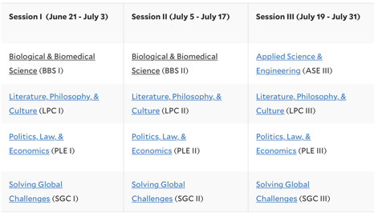
Seren-Yale Young Global Scholars Partnership 2020
Courses & dates

Slide 10
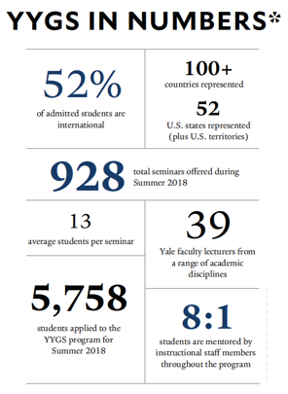


Seren-Yale Young Global Scholars Partnership 2020

Slide 11
Seren-Yale Young Global Scholars Partnership 2020
Who should apply to YYGS?
How to Apply
The Yale Young Global Scholars Program is designed to challenge top performing high school students with fast-paced, university-level material. Prior to arriving at Yale, students are required to do preparatory reading and during the program will spend the majority of each day in lectures, seminars, and small-group discussions. Participants also complete a major writing and presentation assignment in which they are asked to collaborate with a team of students. The academic work in the program is intense and each session covers a wide variety of material in two weeks. Students must also be mature and able to engage respectfully and civilly in discussions over controversial intellectual, moral, and political issues.
Students in the program have:
excellent academic records
demonstrated leadership potential
strong written and verbal communication skills
desire and ability to work cooperatively with peers
strong work ethics
an ability to read, analyse, and reflect on difficult material
high standards of personal and professional conduct
All applications to the Yale Young Global Scholars (YYGS) Program must be made directly to YYGS online. Go to globalscholars.yale.edu or click here.
Seren pupils must also complete the 2020 Seren International Programme Scholarship Application Form (click here) if you wish to receive financial support from the Welsh Government & Seren to attend the Yale Young Global Scholars (YYGS) Program in 2020.

Slide 12
Seren-Yale Young Global Scholars Partnership 2020
Required application components
Personal Information
Activities List
1 x 500 word essay
1 x 200 word short response
Official school transcript (typically GCSE certificates for Seren pupils)
2 x Letters of Recommendation (as completed YYGS Recommendation Forms Only)
Apply for Financial Aid*
Application Fee** ($70)
Go to ‘Review’, and click ‘Finalize & Pay’
2020 Seren International Summer Programme Scholarship Application Form (click here)
*The YYGS financial aid form requires a written statement of need outlining that you require funding to be able to attend YYGS. The form also asks you and your parents/guardians to provide supporting documentation. These can include tax Returns, payroll documents such as payslips, a P60 or a P45, bank statements and other additional documents. Please review this section thoroughly in advance so that you can collate the information needed.
**There is a $70 (approx. £57) application fee for applying to YYGS. YYGS will waive the application fee if it constitutes a significant financial burden for the student’s family. Please see guidance on this on page 14 of the sample application form linked to here.
Accessing funding
The Seren-YYGS Scholarship will be given to up to 30 Seren students in 2020 to cover the programme fees of $6,300/student***
Admitted students will be required to fund or raise sponsorship for the cost of flights. The Welsh Government, Seren, Equal Education and other organisations & sponsors will also be supporting the cost of flights for pupils most in need of this additional financial support to attend YYGS.
Apply directly to YYGS via globalscholars.yale.edu
Complete the 2020 Seren International Summer Programme Scholarship Application Form (click here)
Complete the Financial Aid section of the YYGS application form in full with as much information as possible.
***The funding available through Seren’s partnerships and scholarships will cover programme fees, including tuition, accommodation, board/meals, activities & health insurance. Other costs will include flights, airport transfers, and miscellaneous expenses such as spending money. Please note that separate additional sponsorship is being raised from a range of organisations and individuals to support the costs of flights for the successful students most in need of this additional support (eligibility criteria will apply).

Slide 13
Seren-Yale Young Global Scholars Partnership 2020
Advice & guidance
Top tips
Check that you’re eligible to attend the Yale Young Global Scholars Program (that’s on their website) and check that you’re eligible for support from Seren if you get in (you must be a Seren pupil in Year 12 currently) - you must meet all eligibility criteria to be admitted and to receive support from Seren to attend in 2020.
Research the Yale Young Global Scholars (YYGS) Program and the courses you’re interested in.
Reach out to any Seren students you know of who have attended YYGS previously.
Start your application early! Take a look at what a sample application form looks like (click here) and allow enough time to get this done.
Attend an online webinar for advice about making a strong application to YYGS from Yale alumnus Liam Rahman.
Complete the 2020 Seren International Summer Programme Scholarship Application Form (click here)
Use your essays to demonstrate to YYGS who you are beyond your grades and other academic achievements (these will be on your transcript/results certificates and written about by your teachers in their recommendations). The essays questions will encourage some introspection and perhaps some creativity.
Ask your teachers for recommendations/references early (they will be writing UCAS references for other pupils applying to university around the same time, so advanced warning will help them and result in you having a better reference!)
Speak to your parents/carers/guardians about applying and the information you’ll need from them.
Complete the financial aid section of your YYGS application in full.
Proof-read your application!
Submit your application on time (this includes the teacher references, certificates and the financial aid application being submitted on time). No exceptions will be made for late submission of applications.

Slide 14
Seren-Yale Young Global Scholars Partnership 2020
Frequently Asked Questions (FAQs)
Who should apply to the YYGS summer 2019 program?
Yale Young Global Scholars (YYGS) summer 2020 program is open to applications from anybody who meets the eligibility criteria described on the YYGS website. Please see the following link for details: https://globalscholars.yale.edu/applying/eligibility-requirements. However, the Seren-YYGS Scholarship is only available to Seren students currently in Year 12 or the first year of A Levels at college if attending a further education college.
Can students who are NOT members of Seren apply?
Yale Young Global Scholars (YYGS) is open to applications from anybody who meets the eligibility criteria described on the YYGS website. Please see the following link for details: https://globalscholars.yale.edu/applying/eligibility-requirements. However, the Seren-YYGS Scholarship is only available to Seren pupils in Year 12 (or the first year of college) who are successful in their applications to the YYGS summer 2020 program
As a Seren student, will I be guaranteed a position in the YYGS summer 2020 program?
No, Seren cannot guarantee the success of any individual application to YYGS. YYGS’s application process is highly competitive. Whilst the Seren-YYGS Partnership has identified up to 30 places that can be funded for Seren students in 2020, the standard of applications must still be high enough to be worthy of an offer of admission independently of the partnership. Applications will be considered by the YYGS admissions team and final decisions for admission to YYGS will be made by the YYGS admissions team. Only the top 30 Seren students offered admission to YYGS in 2020 will be supported by the Seren-YYGS Scholarship.
What does the Seren-YYGS Scholarship cover?
The programme cost for each session of the 2020 Yale Young Global Scholars Program is $6,300 USD. This includes instruction, housing on one of Yale’s historic residential colleges in New Haven, three meals per day, and health insurance. Travel is not included in program tuition. The Seren-Yale Young Global Scholars Scholarship covers this $6,300 USD. This has been made possible jointly by Yale Young Global Scholars and The Welsh Government.
How likely is it that my traveling costs will be covered?
The $6,300 USD Seren-YYGS Scholarship does not cover traveling expenses. However, as was done for 2018 and 2019, the Seren and a number of private sponsors will raise funds to support pupils most in need of financial support for the costs of flights so this consideration should not deter eligible and able Seren students from applying to YYGS in 2020. Students are also encouraged develop their own fundraising plans or initiatives for traveling expenses and to make Seren aware of these efforts should you be successful in gaining admission to YYGS. Students should also consider miscellaneous expenses while participating in the program.
Do I need to complete the financial aid portion of the Yale Young Global Scholars (YYGS) Program application if I’m a Seren student?
Yes, all applicants to the Seren-Yale Scholarship for YYGS summer 2020 must complete the financial aid portion of the application to be considered for this scholarship. Students who do not apply for financial aid will not be eligible for the Seren-YYGS scholarship. Please note that any admitted students who do not apply for financial aid will need to raise funds to cover their tuition independently of the Seren-Yale Young Global Scholars 2020 Partnership. All Seren students will also need to complete the 2020 Seren International Summer Programme Scholarship Application Form (click here).
How do I pay the $70 application fee? Is this covered by the scholarship?
Ordinarily, all applicants (including Seren students) must pay the $70 application fee. YYGS will waive the application fee if it would constitute a significant financial burden for the student’s family.
How will YYGS know that I’m a Seren student and how do I notify them?
To for support from Seren to take part in YYGS 2020, you must complete the Seren International Summer Programme Scholarship Application Form (click here). Please also inform your Seren hub coordinator of your application to YYGS. Additionally, when you complete your YYGS application, you will be asked to identify yourself as a Seren student. Please ensure that you do this.
Would I be travelling to Yale independently or would someone be with me?
YYGS summer 2020 has three different start dates ranging from mid-June through to late-July. Seren’s appointed travel coordinator will work with successfully admitted Seren students to coordinate travel arrangements so that all Seren students attending YYGS in the same session (dates) travel to the US and back together. Although it is highly likely that Seren students will be represented in all three cohorts of YYGS 2020, in case this is not the case, all students should be prepared to travel independently or if not have a parent/guardian who is prepared to travel with them.
What if I miss the deadline?
If you miss the application deadline, your application to YYGS will not be considered. All parts of the application must be complete for consideration for admission to YYGS.
When will I be notified whether my application to YYGS 2020 has been successful or not?
Applicants will be notified electronically of admissions decisions by late March 2020.
I have more questions relating to YYGS, where should I go?
See page 30 of this document.

Slide 15
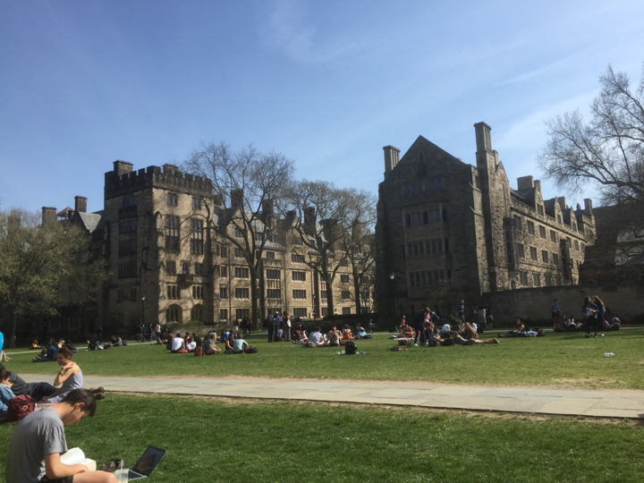

Slide 16



Seren-Harvard Summer School
Scholarship in 2020
Summary of the programme
Courses & dates
How to apply
Accessing funding
Advice & guidance
Frequently Asked Questions (FAQs)

Slide 17
Seren-Harvard Summer School Scholarship 2020
Summary
The 2020 Seren-Harvard Summer School Scholarship
The Seren-HSS Scholarship will enable up to 20 Seren students to attend the Harvard Summer School in 2020. The scholarships of $4,850 per student will cover programme fees, including tuition, accommodation, board/meals, activities & health insurance. Please see page 19 for more information. Please note that additional students could be admitted on a self-funded basis.
Overview
The Pre-College Program is an immersive, collaborative, and transformative residential experience. Alongside peers from around the world, you’ll thrive in a dynamic and supportive academic environment.
Dates/Sessions
Cohort 1: 28 June – 10 July 2020
Cohort 2: 12 July – 24 July 2020
Cohort 3: 26 July – 7 August 2020
Application deadline:
11:59 PM Eastern Time Friday, 31st January 2020
Application Fee: $75 - see page 19 for more information
More information
Harvard Summer School website
Program & course information
How to Apply (please note that you must also complete the Seren International Programme Scholarship Application Form to be able to access funding from Seren for this opportunity)
Eligibility criteria for HSS (please note that you must also be a Year 12 Seren student to be eligible for financial support from the Welsh Government for this opportunity).
Courses
A wide range of courses are on offer across the sciences, social sciences, arts and. humanities. With over 30 courses to choose from in each session, you’re sure to find a topic that interests you. 2020 courses will be posted in late January. Until then, you can review the 2019 courses.
￼

Slide 18
Seren-Harvard Summer School Scholarship 2020
How to apply
How to apply
Required application components
Personal Information
Activities List
4 x 250-350 word essays
1 x 200 word short response
Official school transcript (typically GCSE certificates for Seren pupils)
2 x Letters of Recommendation
Application Fee* ($75)
Go to ‘Review’, and click ‘Submit Your Application’
2020 Seren International Summer Programme Scholarship Application Form (click here)
Seren applicants to the Harvard Summer School do not need to complete the Financial Aid section of the application. Please note that only the top 20 Seren applicants to the Harvard Summer School in 2020 will be given financial support from Seren.
All applications to the Harvard Summer School Pre-College Program must be made directly to the Harvard Summer School online. Go to summer.harvard.edu or click here.
Seren pupils must also complete the 2020 Seren International Programme Scholarship Application Form found at the link below if you wish to receive financial support from the Welsh Government & Seren to attend the Harvard Summer School Pre-College Program in 2020.
*If the application fee constitutes a significant financial burden for the student and/or their family, the student can obtain an application fee waiver code from Equal Education. The fee waiver option is only available for students who need it and for whom the application fee is a significant financial burden. Students who require a fee waiver code must have the support of an official at their school or college to do so. Please email liam@equaleducation.org.uk.

Slide 19
Seren-Harvard Summer School Scholarship 2020
Accessing funding
The Seren-Harvard Summer School Scholarship will be given to up to 20 Seren students in 2020 to cover the programme fees of $4,850/student*
Admitted students will be required to fund or raise sponsorship for the cost of flights. The Welsh Government, Seren, Equal Education and other organisations & sponsors will also be supporting the cost of flights for pupils most in need of this additional financial support to attend.
Apply directly via summer.harvard.edu
Pay the $75 application fee to the Harvard Summer School**
Complete the 2020 Seren International Summer Programme Scholarship Application Form (click here)
*The funding available through Seren’s partnerships and scholarships will cover programme fees, including tuition, accommodation, board/meals, activities & health insurance. Other costs will include flights, airport transfers, and miscellaneous expenses such as spending money. Please note that separate additional sponsorship is being raised from a range of organisations and individuals to support the costs of flights for the successful students most in need of this additional support (eligibility criteria will apply).
**If the application fee constitutes a significant financial burden for the student and/or their family, the student can obtain an application fee waiver code from Equal Education. The fee waiver option is only available for students who need it and for whom the application fee is a significant financial burden. Students who require a fee waiver code must have the support of an official at their school or college to do so. Please email liam@equaleducation.org.uk.

Slide 20
Seren-Harvard Summer School Scholarship 2020
Advice & guidance
Top tips
Check that you’re eligible to attend the Harvard Summer School Pre-College Program (that’s on their website) and check that you’re eligible for support from Seren if you get in (you must be a Seren pupil in Year 12 currently) - you must meet all eligibility criteria to be admitted and to receive support from Seren to attend in 2020.
Research the Harvard Summer School Pre-College Program and the courses you’re interested in (note that course titles will be released in late January 2020).
Reach out to any Seren students you know of who have attended the Harvard Summer School previously.
Start your application early!
Attend an online webinar for advice on making a strong application from Yale alumnus Liam Rahman.
Complete the 2020 Seren International Summer Programme Scholarship Application Form (click here).
Use your essays to demonstrate to the Harvard Summer School who you are beyond your grades and other academic achievements; these will be on your transcript/results certificates and written about by your teachers in their recommendations. The essays questions will encourage some introspection and perhaps some creativity.
Ask your teachers for recommendations/references early (they will be writing UCAS references for other pupils applying to university around the same time, so advanced warning will help them and result in you having a better reference!).
Proof-read your application!
Submit your application on time (this includes the teacher references and certificates being submitted on time). No exceptions will be made for late submission of applications.

Slide 21
Seren-Harvard Summer School Scholarship 2020
Frequently Asked Questions (FAQs)
Who should apply to the Harvard Summer School Pre-College Program?
The Harvard Summer School Pre-College Program is open to applications from anybody who meets the eligibility criteria described on the HSS website. However, the Seren-HSS Scholarship is only available to Seren students currently in Year 12 or the first year of A Levels at college if attending a further education college.
Can students who are NOT members of Seren apply?
The Harvard Summer School Pre-College Program is open to applications from anybody who meets the eligibility criteria described on the HSS website. Please see the following link for details: https://globalscholars.yale.edu/applying/eligibility-requirements. However, the Seren-HSS Scholarship is only available to Seren pupils in Year 12 (or the first year of college) who are successful in their applications to the HSS summer 2020 program
As a Seren student, will I be guaranteed a position in the Harvard Summer School summer 2020 program?
No, Seren cannot guarantee the success of any individual application to HSS. HSS’s application process is highly competitive. Whilst the Seren-HSS Partnership has identified up to 20 places that can be funded for Seren students in 2020, the standard of applications must still be high enough to be worthy of an offer of admission independently of the partnership. Applications will be considered by the HSS admissions team and final decisions for admission to HSS will be made by the HSS admissions team. Only the top 20 Seren students offered admission to HSS in 2020 will be supported by the Seren-HSS Scholarship.
What does the Seren-HSS Scholarship cover?
The programme cost for each session of the 2020 Harvard Summer School Pre-College Program is $4,850 USD. This includes instruction, housing on one of Harvard’s residential colleges, three meals per day, and health insurance. Travel is not included in program tuition. The Seren-Harvard Summer School Scholarship covers this $4,850 USD.
How likely is it that my traveling costs will be covered?
The $4,850 USD Seren-Harvard Summer School Scholarship does not cover traveling expenses. However, as was done for 2019, Seren and a number of private sponsors will raise funds to support pupils most in need of financial support for the costs of flights so this consideration should not deter eligible and able Seren students from applying to HSS in 2020. Students are also encouraged develop their own fundraising plans or initiatives for traveling expenses and to make Seren aware of these efforts should you be successful in gaining admission to HSS. Students should also consider miscellaneous expenses while participating in the program.
Do I need to complete the financial aid portion of the Harvard Summer School Pre-College Program application if I’m a Seren student?
No. You do not need to complete the financial aid portion of the Harvard Summer School application. Up to 20 Seren students will be supported to attend the Harvard Summer School in 2020.
How do I pay the $75 application fee? Is this covered by the scholarship?
Ordinarily, all applicants to the Harvard Summer School’s Pre-College Program (including Seren students) must pay the $75 application fee. If the application fee constitutes a significant financial burden for the student and/or their family, the student can obtain an application fee waiver code from Equal Education. The fee waiver option is only available for students who need it and for whom the application fee is a significant financial burden. Students who require a fee waiver code must have the support of an official at their school or college to do so. Please email liam@equaleducation.org.uk.
How will the Harvard Summer School know that I’m a Seren student and how do I notify them?
To apply for support from Seren to take part in HSS 2020, you must complete the Seren International Summer Programme Scholarship Application Form (click here). Please also inform your Seren hub coordinator of your application to HSS. Additionally, when you complete your HSS application, you will be asked to identify yourself as a Seren student. Please ensure that you do this.
Would I be travelling to Harvard independently or would someone be with me?
In 2020, Harvard Summer School’s Pre-College Program has three different start dates ranging from mid-June through to late-July. Seren’s appointed travel coordinator will work with successfully admitted Seren students to coordinate travel arrangements so that all Seren students attending HSS in the same session (dates) travel to the US and back together. Although it is highly likely that Seren students will be represented in all three cohorts of HSS 2020, in case this is not the case, all students should be prepared to travel independently or if not have a parent/guardian who is prepared to travel with them.
What if I miss the deadline?
If you miss the application deadline, your application to HSS will not be considered. All parts of the application must be complete for consideration for admission to HSS.
When will I be notified whether my application to HSS 2020 has been successful or not?
Applicants will be notified electronically of admissions decisions by late February 2020.
I have more questions relating to HSS, where should I go?
See page 30 of this document.

Slide 22


Slide 23


Seren-University of Chicago Summer Session Partnership
Summary of the University of Chicago Summer Session Immersion & Pathways programmes
Courses & dates
How to apply
Accessing Funding
Advice & guidance
Frequently Asked Questions (FAQs)

Slide 24
Seren—Chicago Summer Session Partnership 2020
Summary
The 2020 Seren-Chicago Summer Session Scholarship
The Seren-Chicago Scholarship will enable up to 4 Seren students to attend the University of Chicago Summer Session in 2020. The scholarships of $7,100 per student will cover programme fees, including tuition, accommodation, board/meals, activities & health insurance.
Immersion & Pathways Programs
Immerse yourself in one of your passions and take advantage of the rich educational resources offered by the University and the city of Chicago through our summer Immersion programs for high school students. In these undergraduate-level courses, you will get personalized attention from faculty, researchers, and other professionals who will lead you through labs, workshop discussions, field observations, research projects, and other hands-on activities.
Each three-week program provides a broad overview of how scholars at the University of Chicago articulate problems and apply solutions in a particular field of study—Economics, Human Rights, Law, Molecular Engineering, Data Science, and more. Through a series of lectures led by faculty members and research associates, students delve into a variety of perspectives and topics. University of Chicago students serve as Teaching Assistants, meeting regularly with participants to discuss what they have heard, read, and seen, and work with faculty to provide special opportunities for further learning, such as labs and off-campus trips.
Application deadline:
11:59 PM Eastern Time Wednesday, 22nd January 2020
Application Fee: $0 – application fee waived by University of Chicago
More information
University of Chicago Summer Session website
Immersion Program
Pathways Program
University of Chicago YouTube channel
How to Apply (You must also complete the Seren Scholarship Application Form.)
You must also be a Year 12 Seren student to be eligible for support from Seren for this opportunity.
Courses
Immersion Program – 27 courses to choose from
Pathways Program – 10 courses to choose from

Slide 25
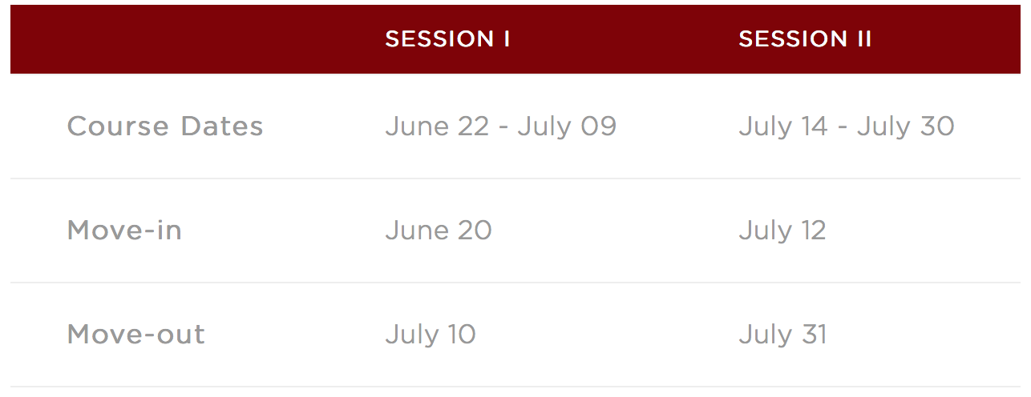

Seren—Chicago Summer Session Partnership 2020
How to Apply
Courses & dates
All applications to the University of Chicago’s Immersion or Pathways Summer Session Programs must be made directly to UChicago online. Go to summer.chicago.edu or click here.
Seren pupils must also complete the 2020 Seren International Programme Scholarship Application Form (click here) if you wish to receive financial support from the Welsh Government & Seren to attend the UChicago Summer Session Program in 2020.

Slide 26
Seren—Chicago Summer Session Partnership 2020
Required application components
Personal Information
Activities List
Essay Responses to questions asked by UChicago
A Writing sample (including teachers’ grades and comments)
Official school transcript (typically GCSE certificates for Seren pupils)
Up to 3 x Letters of Recommendation
Parental confirmation emails
2020 Seren International Summer Programme Scholarship Application Form (click here)
See: https://summer.uchicago.edu/apply
Accessing funding
The Seren-Chicago Scholarship will be given to up to 4 Seren students in 2020 to cover the programme fees of $7,100/student***
Admitted students will be required to fund or raise sponsorship for the cost of flights. The Welsh Government, Seren, Equal Education and other organisations & sponsors will also be supporting the cost of flights for pupils most in need of this additional financial support to attend UChicago.
Apply directly to UChicago via summer.chicago.edu
Complete the 2020 Seren International Summer Programme Scholarship Application Form (click here)
***The funding available through Seren’s partnerships and scholarships will cover programme fees, including tuition, accommodation, board/meals, activities & health insurance. Other costs will include flights, airport transfers, and miscellaneous expenses such as spending money. Please note that separate additional sponsorship is being raised from a range of organisations and individuals to support the costs of flights for the successful students most in need of this additional support (eligibility criteria will apply).

Slide 27
Seren-Chicago Summer Session Scholarship 2020
Advice & guidance
Top tips
Check that you’re eligible to attend the University of Chicago’s Summer Session Immersion or Pathways program (that’s on their website) and check that you’re eligible for support from Seren if you get in (you must be a Seren pupil in Year 12 currently) - you must meet all eligibility criteria to be admitted and to receive support from Seren to attend in 2020.
Research the University of Chicago’s Immersion and Pathways programmes and the courses you’re interested in.
Reach out to any Seren students you know of who have attended Seren International Summer programmes previously.
Start your application early!
Attend an online webinar for advice on making a strong application from Yale alumnus Liam Rahman.
Complete the 2020 Seren International Summer Programme Scholarship Application Form (click here).
Use your essays to demonstrate to the Chicago Summer Session who you are beyond your grades and other academic achievements; these will be on your transcript/results certificates and written about by your teachers in their recommendations. The essays questions will encourage some introspection and perhaps some creativity.
Ask your teachers for recommendations/references early (they will be writing UCAS references for other pupils applying to university around the same time, so advanced warning will help them and result in you having a better reference!).
Proof-read your application!
Submit your application on time (this includes the teacher references and certificates being submitted on time). No exceptions will be made for late submission of applications.

Slide 28
Seren-Chicago Summer Session Scholarship 2020
Frequently Asked Questions (FAQs)
Who should apply to the University of Chicago Summer Session Immersion or Pathways program?
The Chicago Summer Session Immersion and Pathways programmes are open to applications from anybody who meets the eligibility criteria described on the summer.chicago.edu website. However, the Seren-Chicago Scholarship is only available to Seren students currently in Year 12 or the first year of A Levels at college if attending a further education college.
Can students who are NOT members of Seren apply?
The Seren-Chicago Scholarship is only available to Seren pupils in Year 12 (or the first year of college) who are successful in their applications to the summer 2020 program
As a Seren student, will I be guaranteed a position in the University of Chicago Summer Session 2020 program?
No, Seren cannot guarantee the success of any individual application to Chicago. UChicago’s application process is highly competitive. Whilst the Seren-Chicago Partnership has identified up to 4 places that can be funded for Seren students in 2020, the standard of applications must still be high enough to be worthy of an offer of admission independently of the partnership. Applications will be considered by the UChicago admissions team and final decisions for admission will be made by the Chicago admissions team. Only the top 4 Seren students offered admission to the UChicago Summer Session in 2020 will be supported by the Seren-Chicago Scholarship.
What does the Seren-Chicago Scholarship cover?
The programme cost for either the Immersion or Pathways summer session at UChicago is $7,100 USD. This includes instruction, housing on one of Chicago’s residential houses, three meals per day, and health insurance. Travel is not included in program tuition. The Seren-Chicago Scholarship covers this $7,100 USD.
How likely is it that my traveling costs will be covered?
The $7,100 USD Seren-Chicago Scholarship does not cover traveling expenses. However, as was done for 2019, Seren and a number of private sponsors will raise funds to support pupils most in need of financial support for the costs of flights so this consideration should not deter eligible and able Seren students from applying to Uchicago Summer Session in 2020. Students are also encouraged develop their own fundraising plans or initiatives for traveling expenses and to make Seren aware of these efforts should you be successful in gaining admission to Chicago. Students should also consider miscellaneous expenses while participating in the program.
Do I need to complete the financial aid portion of the application if I’m a Seren student?
No. You do not need to complete the financial aid portion of the Chicago application. Up to 4 Seren students will be supported to attend the UChicago Summer Session in 2020.
What about the $25 application fee? Will I need to pay this?
No. The University of Chicago waives the $25 application fee for Seren students applying to the Immersion or Pathways programmes.
How will the University of Chicago know that I’m a Seren student and how do I notify them?
To apply for support from Seren to take part in UChicago’s Summer Session Immersion or Pathways programmes in 2020, you must complete the Seren International Summer Programme Scholarship Application Form (click here). Please also inform your Seren hub coordinator of your application to UChicago. Additionally, when you complete your Chicago application, you will be asked to identify yourself as a Seren student. Please ensure that you do this.
Would I be travelling to Chicago independently or would someone be with me?
In 2020, Uchicago’s Immersion and Pathways programmes have two different session dates. Seren’s appointed travel coordinator will work with successfully admitted Seren students to coordinate travel arrangements so that Seren students attending UChicago in the same session (dates) travel to the US and back together. Although it is highly likely that Seren students will be represented in both cohorts of Uchicago’s summer session in 2020, if this is not the case, all students should be prepared to travel independently or if not have a parent/guardian who is prepared to travel with them.
What if I miss the deadline?
If you miss the application deadline, your application to UChicago Summer Session will not be considered. All parts of the application must be complete for consideration for admission to UChicago.
When will I be notified whether my application to UChicago 2020 has been successful or not?
Applicants will be notified electronically of admissions decisions by late February 2020.
I have more questions relating to UChicago, where should I go?
See page 30 of this document.

Slide 29
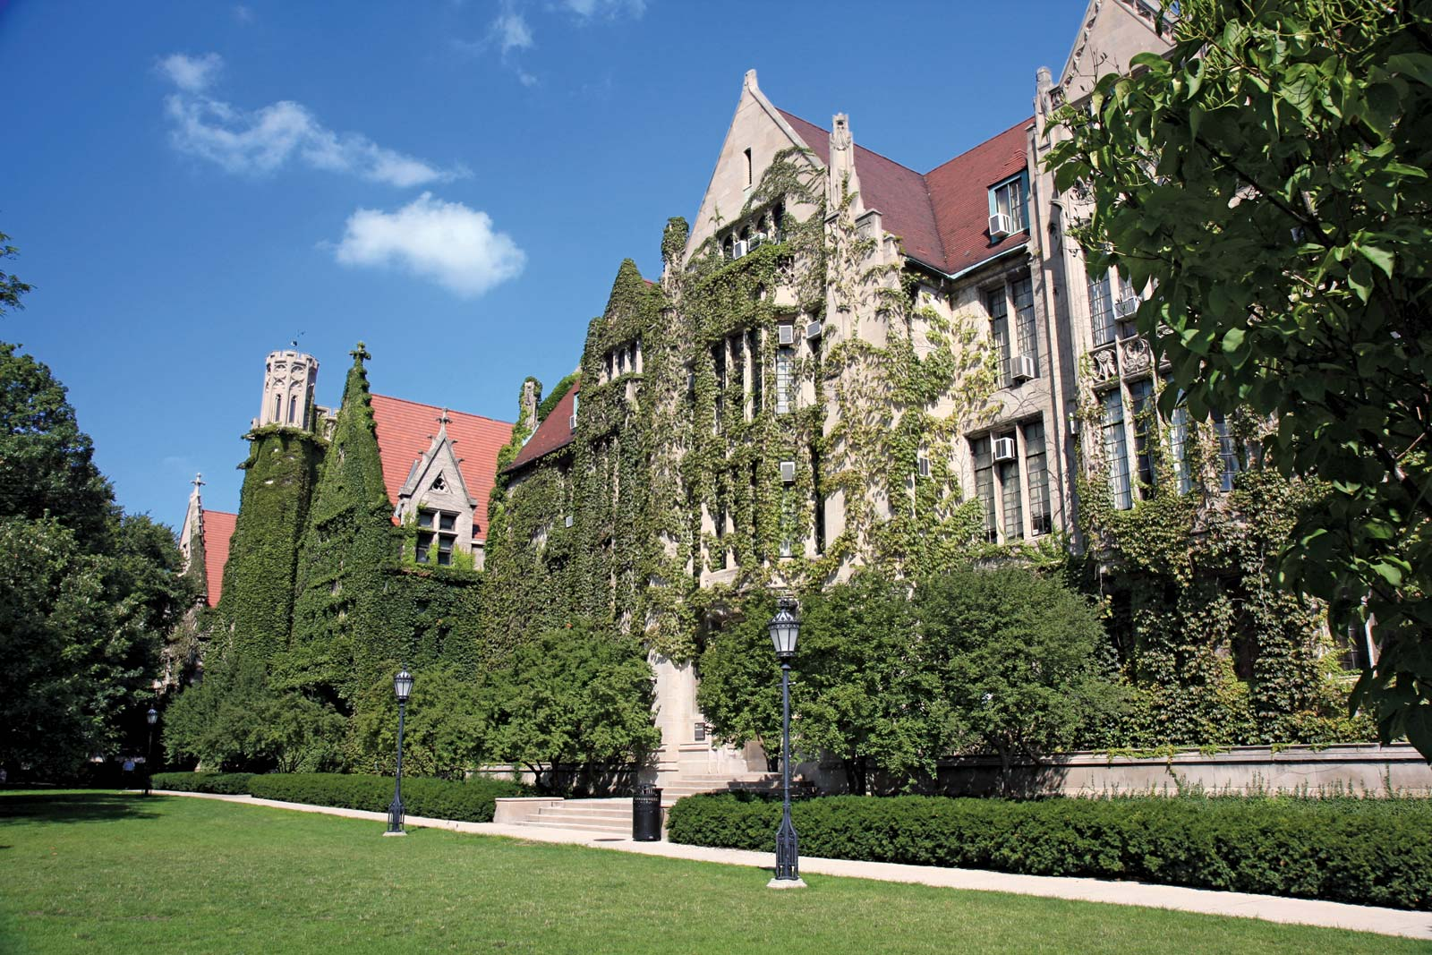

Slide 30
Finding out more: Webinars & Live Q&As
What will be covered in the webinars?
An overview of Seren’s international summer opportunities in 2020
More information regarding the Yale Young Global Scholars (YYGS) Program
More information regarding the Harvard Summer School Pre-College Program
More information regarding the University of Chicago Pathways & Immersion Summer Sessions
An overview of both application processes
Guidance re: the Activities Lists & Essay Questions asked by each application
Guidance re: Teacher Recommendations & their role in the selection process
Funding offered by Seren for programme fees & completing financial aid questions
Completing the Seren International Summer Programme Scholarship Application Form
Application fees & fee waivers
Flight sponsorship and accessing further financial support to attend
An overview of pre-departure briefings and support provided
Q&A
What will be covered in the Facebook Live Q&As?
An overview of the Seren International opportunities in 2020 programmes
An interactive dialogue with students applying, teachers writing recommendations & parents/carers, responding to questions posed live and common questions asked in advance of the session

Slide 31
Online Webinars
Webinars
5pm Wednesday, 8th January 2020 – YYGS & Harvard Summer School
  To join, go to https://equaleducation.clickmeeting.com/170008012020
  or call 020 7048 4146 (PIN: 288827#)
7pm Monday, 13th January 2020 – YYGS & Chicago Summer Sessions
  To join, go to https://equaleducation.clickmeeting.com/130120201900
  or call 020 7048 4146 (PIN: 443915#)
7pm Thursday, 16th January 2020 – Chicago Summer Session only
  To join, go to https://equaleducation.clickmeeting.com/160120201900
  or call 020 7048 4146 (PIN: 649371#)
7pm Thursday, 23rd January 2020 – Harvard Summer School only
  To join, go to https://equaleducation.clickmeeting.com/230120201900
  or call 020 7048 4146 (PIN: 592685#)
We encourage you to join a webinar as soon as possible. Although the content will be the same in all webinars, you are welcome to join more than once if you have more questions you’d like to ask.

Slide 32
Facebook Live Sessions
What will be covered in the Facebook Live Q&As?
An overview of the Seren International opportunities in 2020 programmes
An interactive dialogue with students applying, teachers writing recommendations & parents/carers, responding to questions posed live and common questions asked in advance of the session
Dates & Times
4pm Friday, 3rd January 2020: Facebook Live via Seren’s Facebook page
4pm Friday, 10th January 2020: Facebook Live via Seren’s Facebook page
To join the Facebook Live Sessions about Seren’s international summer opportunities in 2020, you’ll need to have a Facebook account and go to Seren’s Facebook page at the time of the live session.

Slide 33
Further questions & support
If your question relates specifically to the summer programmes and what they offer, in the first instance see the information on the individual programme websites:
Yale Young Global Scholars (YYGS) Program: globalscholars.yale.edu
Harvard Summer School Pre-College Program: summer.harvard.edu
Chicago Summer Session: summer.uchicago.edu
We also encourage you to review this document thoroughly and to join one of our online webinars to find out more.
For further support regarding applying to Seren’s international opportunities in 2020, contact us via the form found at the this link (click here).
You can also reach out by email directly to Liam Rahman at Equal Education. Requests for support made by email will be fulfilled faster than those made by telephone.
liam@equaleducation.org.uk / liam.rahman@aya.yale.edu

Slide 34


